Slide 1
RECURRENT NEURAL NETWORK FOR SENTIMENTAL ANALYSIS
Recurrent Neural Networks(RNN) is a type of artificial neural network designed for processing sequences of data . In sentiment analysis, RNN can be highly effective because the goal is to classify the sentiments such as(positive , negative and neutral , etc.) of a given text . It involves understanding the emotional tone behind the words and Recurrent Neural network is particularly effective for handling sequential data's such as text , speech and time series data.

Slide 2
What is Recurrent Neural Network ?
Recurrent Neural Network is a type of Artificial neural network.
Designed for processing sequence of Data.
Particularly effective for Handling sequential data with varying lengths ,such as text, speech and the time series data.
Maintains a hidden state or memory(RNN are able to retain the memory of previous inputs in the sequence because of the connections that create cycles within the network.
What is Sentiment Analysis ?
It is the process of determining the emotional tone or sentiment expressed in a piece of texts (such as review or social media posts..) expresses a positive , Negative or Neutral sentiment.

Slide 3
The Aim of sentiment analysis is to classify text into categories that reflect the writer's feelings or opinions, typically as positive, negative, or neutral.
Example:-
Positive :- I love this necklace.
Negative :- I hate the necklace design.
Neutral :- The necklace design is okay ,but it could be better.
It aims to predict the sentiment behind a text.
Common use Cases of Sentiment Analysis :-
Product Reviews Social Media Monitoring Customer Feedback
Political Sentiment Brand Monitoring

Slide 4
Why use RNN in sentimental Analysis?
RNN have connections that generate cycles . Which can retain memory of previous words or time steps in the sequence . This memory is crucial in recognizing the sentiment in a sentence because the sentiment might depend on how words relate to each other in context.
Steps to Implement Sentiment Analysis with RNNs :-
Step 1:- Data Collection
Step 2:- Data Preprocessing
Tokenization
(Break texts into Words/Token)
Padding
(RNN require sequences of the same length ,padding is often applied to ensure uniform sequence length for all text)
Vectorization
(Convert the text into numerical format)

Slide 5
Step 3:- Build the RNN Model(RNN model for sentimental analysis includes)
Embedding Layer :- Converts words into dense vectors.
LSTM(Long Short-Term Memory) - Advanced RNN architecture that uses memory cells to store information over a long periods,to process these word vectors and learn sequential dependencies.
GRU(Gated Recurrent Unit) – a simplified version of LSTM , offering a balance between performance and complexity.
Dense layer :- Outputs the sentiment class(Positive ,negative or neutral).
Step 4:- Train the model
To train we use suitable loss function.
Binary–cross entropy for binary sentiment classification.
categorial cross entropy for multi-class classification.
Once the model is build ,we can train it using training data(x_train and y_train) for binary analysis , the labels(x_test and y_test will be 0 or1
Step 5:- Evaluation
Evaluate the model using accuracy, precision, recall and F1 score on a validation or test dataset.

Slide 6
Evaluation Metrics :-
Once model is trained ,we can use metrics such as,
Accuracy : Percentage of correct prediction
Precision/Recall/F1 Score :-Suitable for dealing imbalanced classes.
Confusion Matrix : To visualize false positives and False negatives.
Tools to implement RNN for Sentimental Analysis :-
TensorFlow - Powerful and Flexible framework for building and Training neural network.
PyTorch - Suited for research and prototyping
Keras - - A high-level API built on top of TensorFlow.
etc…..

Slide 7
Key advantages of RNN for Sentimental analysis :-
Contextual Understanding: RNNs can capture the context of words within a sentence, which is crucial for sentiment analysis.
Handling Variable-Length Sequences: RNN can process text sequences of varying lengths, making them flexible for real-world applications.
Learning Complex Patterns: RNNs can learn complex patterns and relationships between words and phrases, and improve the accuracy of sentiment analysis.

Slide 8
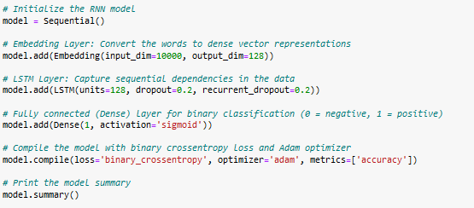
STEPS TO CODE :-
1. Import libraries
2. Load the dataset
3. Process the text data
4. Split the data into training and testing sets.
5. Build the RNN model.

Slide 9

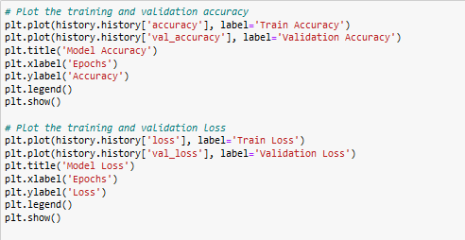
6. Train the model.
7. Evaluate the model
8. Plot the training and validation accuracy.
9. Make the predictions.

Slide 10
Link to Git hub
https://github.com/Hemabindhukrishnan/machine_learning.git
or
https://github.com/Hemabindhukrishnan/machine_learning/blob/714fe53b2760e54ab925e038989689b261bcda85/machine_lear_code.ipynb

Slide 11
Conclusion :-
Recurrent Neural Networks (RNNs), especially Long Short-Term Memory (LSTM) networks, are powerful tools for tasks involving sequential data, such as sentiment analysis . By capturing temporal dependencies, RNNs effectively handle complex patterns in text and numerical data. LSTMs, with their ability to overcome the vanishing gradient problem, excel in learning long-term relationships, making them ideal for applications like sentiment classification.

Slide 12
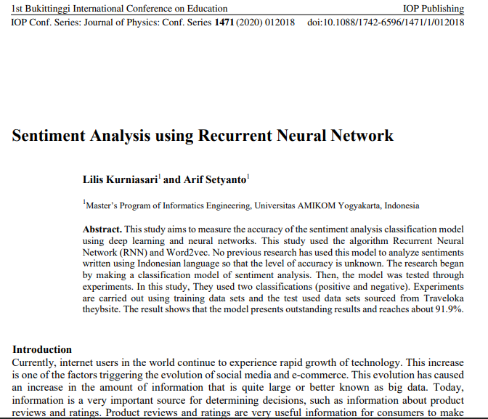
REFERENCES
1. https://iopscience.iop.org/article/10.1088/1742-6596/1471/1/012018/meta
Journal of Physics: Conference Series, Volume 1471, 1st Bukittinggi International Conference on Education 17-18 October 2019, West Sumatera, Indonesia

Slide 13
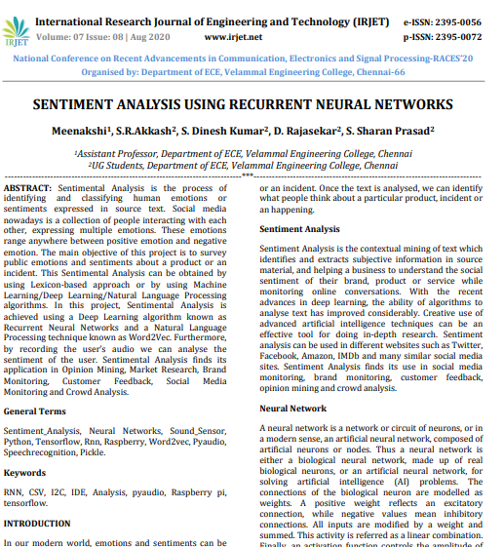
2. https://www.irjet.net/archives/V7/i8/Velammal/NCRACES-41.pdf

